Slide 1

The Cyber Seven’s
Presentation on “Introduction to Programming”

Slide 2
Arrays using Pseudocode Manipulating Arrays
What is an Array?
An array is a collection of similar data elements stored at contiguous memory locations. It is the simplest data structure where each data element can be accessed directly by only using its index number.

Slide 3
Arrays using Pseudocode Manipulating Arrays
What are arrays used for?
In coding and programming, an array is a collection of items, or data, stored in contiguous memory locations, also known as database systems. The purpose of an array is to store multiple pieces of data of the same type together.
Eg: If we want to store the names of 100 people then we can create an array of the string type that can store 100 names. String [] array = new String [100]; Here, the above array cannot store more than 100 names.
Eg: Value: Jim Dave Rod Ash
Index: 0 1 2 3

Slide 4
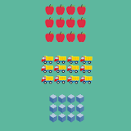
Arrays using Pseudocode Manipulating Arrays
What are arrays used for?
Eg 2 : any arrangement in rows or columns. Cards laid out into rows to play Memory, seats arranged in rows for a recital, or numbers arranged in an Excel spreadsheet are all examples of arrays.
Example: Create an array containing car names:
Cars = ["Ford", "Volvo", "BMW"]

Slide 5
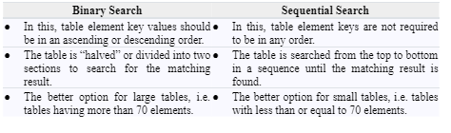
Manipulating Arrays searching & sorting
Distinguish between sequential search and binary search

Slide 6
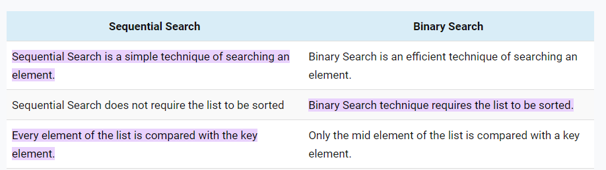
Manipulating Arrays searching & sorting
Distinguish between sequential search and binary search

Slide 7
Manipulating Arrays searching & sorting
Psuedo Code for binary search Algorithm
1 def binarySearch(A, x):
2 n = len(A)
3 beg = 0
4 end = n - 1
5 result = -1
6 while (beg <= end):
7 mid = (beg + end) / 2
8 if (A[mid] <= x):
9 beg = mid + 1
10 result = mid
11 else:
12 end = mid - 1
13 return result

Slide 8
Manipulating Arrays searching & sorting
Demonstrate how binary search operates
https://youtu.be/DnvWAd-RGhk

Slide 9
Manipulating Arrays searching & sorting
Demonstrate how selection sort operates
https://youtu.be/4CykZVqBuCw

Slide 10
Working with Modules using Pseudocode
State advantages of modules
Modules have several advantages, including:
Reusability: Modules can be used in multiple programs, allowing for code reuse and
reducing development time.
Organization: Modules allow for the organization of code into separate, self-contained units,
making it easier to understand and maintain large code bases.
Name spacing: Modules provide a way to organize related functionality under a single name,
reducing the likelihood of naming conflicts.

Slide 11
Working with Modules using Pseudocode
State advantages of modules
Abstraction: Modules can be used to abstract away complex functionality, making it easier
for other developers to understand and use the code.
Encapsulation: Modules can be used to hide implementation details, allowing for changes to
be made without affecting other parts of the program.

Slide 12
Working with Modules using Pseudocode
Define functions
A function is a block of code that performs a specific task and returns a value or output. It is
a reusable piece of code that can be called multiple times by passing different inputs or
parameters. Functions are typically defined using the keyword &quot;function&quot; or &quot;def&quot; in
programming languages such as Python, JavaScript, and C++.

Slide 13
Working with Modules using Pseudocode
Define procedures
A procedure, on the other hand, is a block of code that performs a specific task but does not
return a value or output. Procedures are also reusable, but they are typically used for tasks
that do not require a return value. Procedures are typically defined using the keyword
&quot;procedure&quot; or &quot;sub&quot; in programming languages such as Pascal, Basic, and Fortran.

Slide 14
Working with Modules using Pseudocode
Distinguish between functions and procedures
The main difference between functions and procedures is that a function returns a value or
output, while a procedure does not. Functions are often used to perform calculations or
operations that need to be used elsewhere in the program, while procedures are used for
tasks that don&#39;t require a return value.
Another difference is that functions are often used to simplify complex operations, to make
the code more readable and maintainable. Procedures on the other hand, are used to
perform specific actions or tasks, such as input/output operations, displaying results on the
screen, or updating data in a database.

Slide 15
Working with Modules using Pseudocode
Distinguish between functions and procedures
Functions are typically called by using the function name, followed by parentheses and any
necessary parameters. Procedures, on the other hand, are typically called by using the
procedure name, followed by parentheses and any necessary parameters.
In general, functions are more flexible and powerful than procedures, as they can be used to
return values that can be used in other parts of the program. Procedures, on the other
hand, are simpler and more limited in their functionality.

Slide 16
Working with Modules using Pseudocode
Distinguish between functions and procedures
Functions are typically called by using the function name, followed by parentheses and any
necessary parameters. Procedures, on the other hand, are typically called by using the
procedure name, followed by parentheses and any necessary parameters.
In general, functions are more flexible and powerful than procedures, as they can be used to
return values that can be used in other parts of the program. Procedures, on the other
hand, are simpler and more limited in their functionality.

Slide 17
Working with Modules using Pseudocode
Advantages of using modules
Some advantages of using modules are that it allows the code to be:
Easier to read.
It helps to make the code easier to read by seperating functions that relates to different aspects of the code.
Easier to test
By splitting software into distinctive modes, it allows for an easier testing. It helps in the case where tests becomes stricter and more detailed when testing small functions that do less compared to larger functions that do numerous things.

Slide 18
Working with Modules using Pseudocode
Advantages of using modules
Some advantages of using modules are that it allows the code to be:
Easier to find
Modularity involves the grouping of similar types of functions into their own files and libraries and branching off related helper functions into their own files.
Eg. A specific folder structure that groups files relating to API(Application Programming Interface), UI and core functionality.

Slide 19
Working with Modules using Pseudocode
Advantages of using modules
Reusable without any bloat
It is common to reuse a code or function in multiple places. Modularity allows you to pull it from a single source by calling it from the module or library its located. Doing this is also more efficient than copying and pasting.
Single source for faster fixes
Providing a single source of truth with each module for your specific functions, minimizes the number of places bugs can occur and makes it easier to fix when a bug does occur. It also reduces the risk of problems caused by two pieces of code relying on slightly different implementations of the same functionality. Thus, you only have to fix a bug in one module and everything that uses it will be updated shortly.

Slide 20
Working with Modules using Pseudocode
Advantages of using modules
Easier to refactor
Modular programming allows easier refactoring. This is usually due to a number of reasons but one of which is, for example, both APIs and following a strict file? folder structure can help if you want to script or automate refactoring. Refactoring refers to simply means re-structuring a code without changing or adding to its functionality.
Easier to collaborate
Where multiple teams need to work on different components of a program, modular programming is quite essential. If the code is split between more functions, files, and/or repositories, you can decrease the chances of any issues or conflicts that would occur. This is in the case of multiple developers working on the same piece of code.

Slide 21
Working with Modules using Pseudocode
Writing functions and procedures
Example of a function and procedure in python:
def calculate_area(length):
area = length * length
return area
#def means to define a function
def main():
length = 12
result = calculate_area(length)
print(result)

Slide 22
Working with Modules using Pseudocode
Writing functions and procedures
Example of a funtion and procedure in pseudocode:
FUNCTION calculate_area(length)
area = length * length
RETURN area
ENDFUNCTION
PROCEDURE main()
length = 12
result = calculate_area(length)
PRINT(result)
ENDPROCEDURE

Slide 23
Working with Modules using Pseudocode
Writing functions with parameters or arguments
Example of parameters or arguments in a function:
def my_function(fname):
print(fname + " Refsnes")
my_function("Email")
my_function("Tobias")
my_function("Linux")
From a function perspective:
A parameter is the variable listed inside the parentheses in the function definition, while
an argument is the value that is sent to the function when it is called.

